Slide 1


AWS Serverless Introduction
Building High Available and Scalable applications
This Photo by Unknown Author is licensed under CC BY-SA

Slide 2
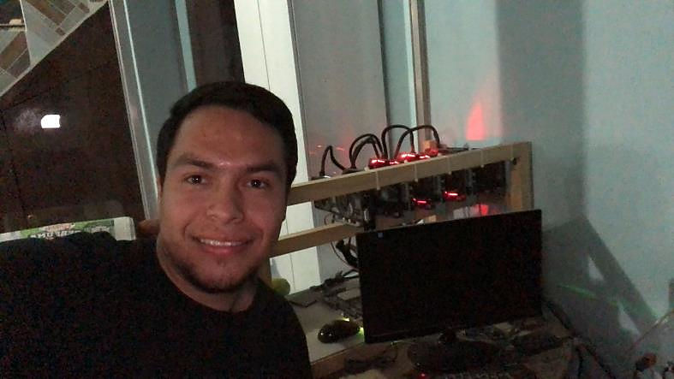
About me… Jesus Guzman
I work at Datum
Cloud Solution Architect
Oracle DBA
Blockchain lover
Friendly
Share knowledge

Slide 3
Cloud Computing
IT Resources OnDemand
Pay As You Go
No Upfront Cost

Slide 4


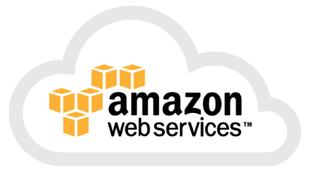


Slide 5
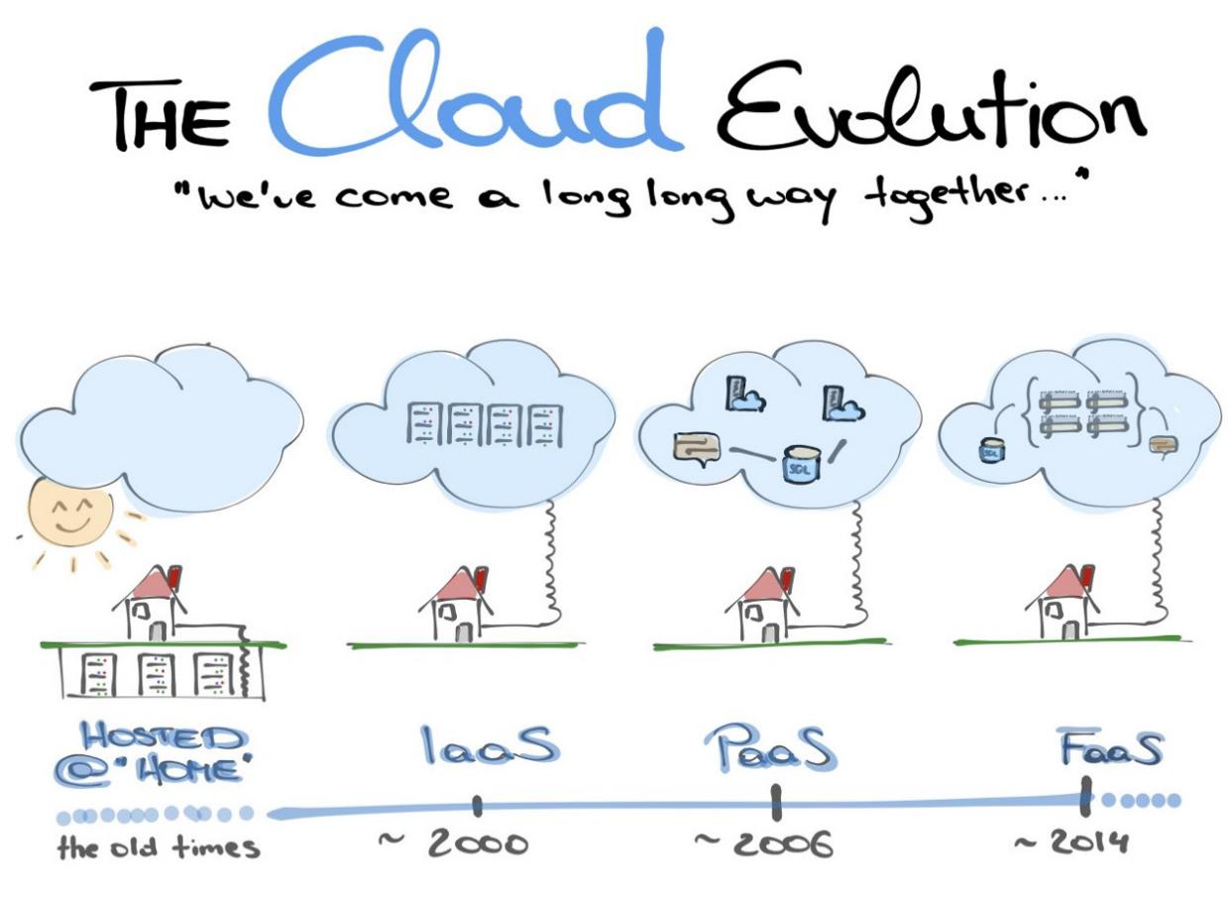
Notes:
https://medium.com/@codeprincess/the-cloud-evolution-3395b2475faf

Slide 6
Serverless Applications

Slide 7
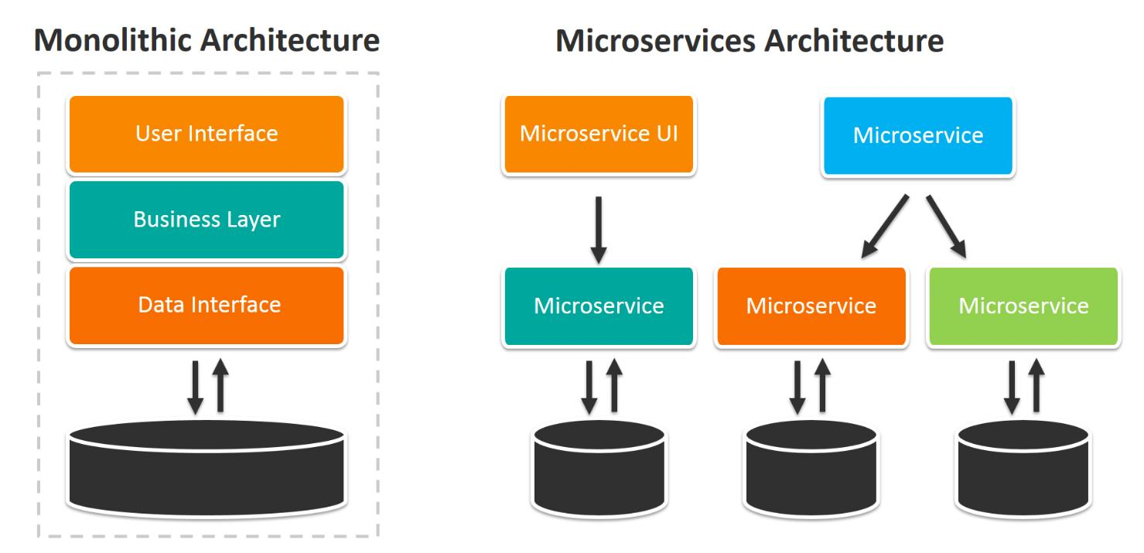
Traditional Applications

Slide 8
Servers :(
Sizing
Load
Capacity
Hacking
How Many
SO
Cost
Access
SO update
Deploy Code
IDLE Time
Availability
Performance
Optimization
Scaling
Configuration
Fault Tolerant
Life Cycle

Slide 9
Serverless mean…
No servers to provision or manage
Scales with usage
Never pay for idle
Built-in availability and fault tolerance

Slide 10

Serverless??

Slide 11

Demo AWS Console

Slide 12
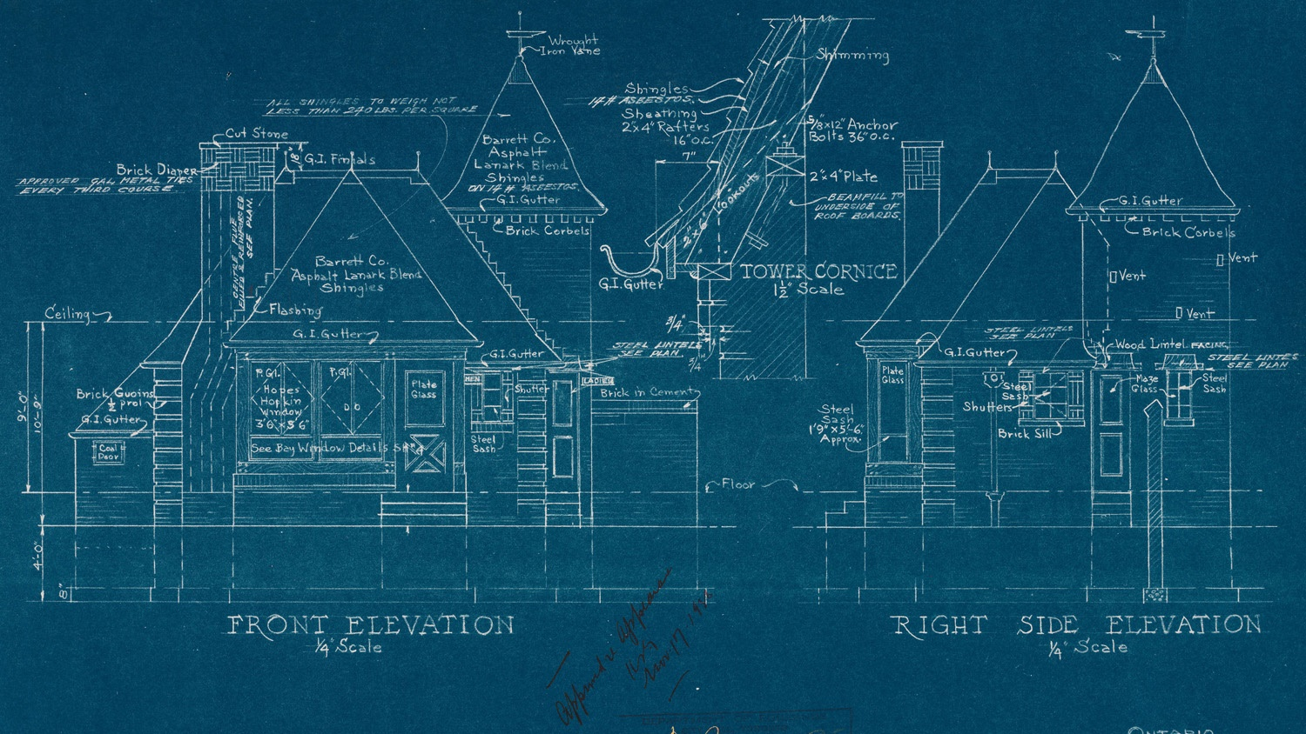





Key AWS Serverless Services
Files
API
Logic
Database
Mail
S3
API Gateway
Lambda
DynamoDB
SES

Slide 13

Amazon S3
Storage Service
Durability 99.999999999%
Storage Classes
Cost-effective
AWS Cloud
Availability Zone 1
Availability Zone 2
Availability Zone 3
S3 Files

Slide 14
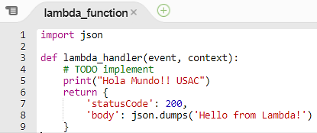
AWS Lambda
Execute code. Don’t worry about servers
Java, Python, C#, Nodejs
Started by Events
Scales with usage
Charge by 100ms

Slide 15
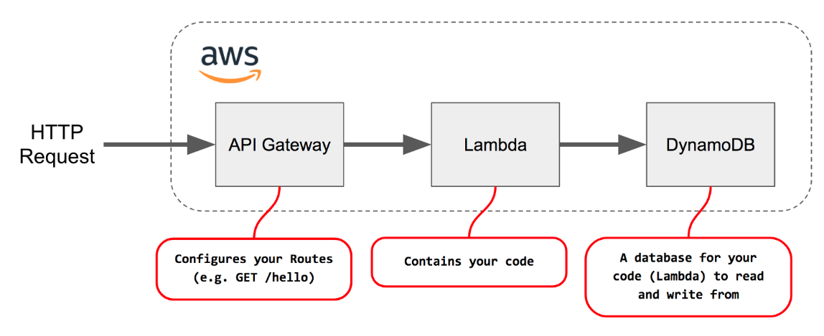
Amazon API Gateway
Unified API Frontend
DDos Protection
Authenticate and authorize
Throttle, meter and monetize

Slide 16
Amazon DynamoDB
NoSQL Database
Scaling OnDemand
Automatic Replication
ACID Support
AWS Cloud
Availability Zone 1
Availability Zone 2
Availability Zone 3
DynamoDB Tables

Slide 17



Amazon SES
Email sending service
High Available
Cost effective
Configurable
S3
Lambda
SES

Slide 18


AWS Contact Form Serverless Architecture
AWS Cloud
SES
Email Notification
S3
Static Web Site
API Gateway
RESTFul API
Lambda
Backend Logic
DynamoDB
Database

Slide 19

I get it!!

Slide 20





















Serverless Services
Compute and API
AWS Lambda
Amazon API Gateway
AWS Appsync
Database, Storage, Orchestration, Analytics
Amazon DynamoDB
AWS Glue
Amazon SES
Amazon Aurora Serverless
Amazon Kinesis
Amazon SQS
Amazon S3
Amazon Athena
AWS Step Functions
Developer Tools and AI
AWS CodeCommit
AWS CodePipeline
Amazon Transcribe
AWS CodeBuilt
Amazon Rekognition
Amazon Lex
AWS CodeDeploy
Amazon Polly
Amazon Comprehend

Slide 21
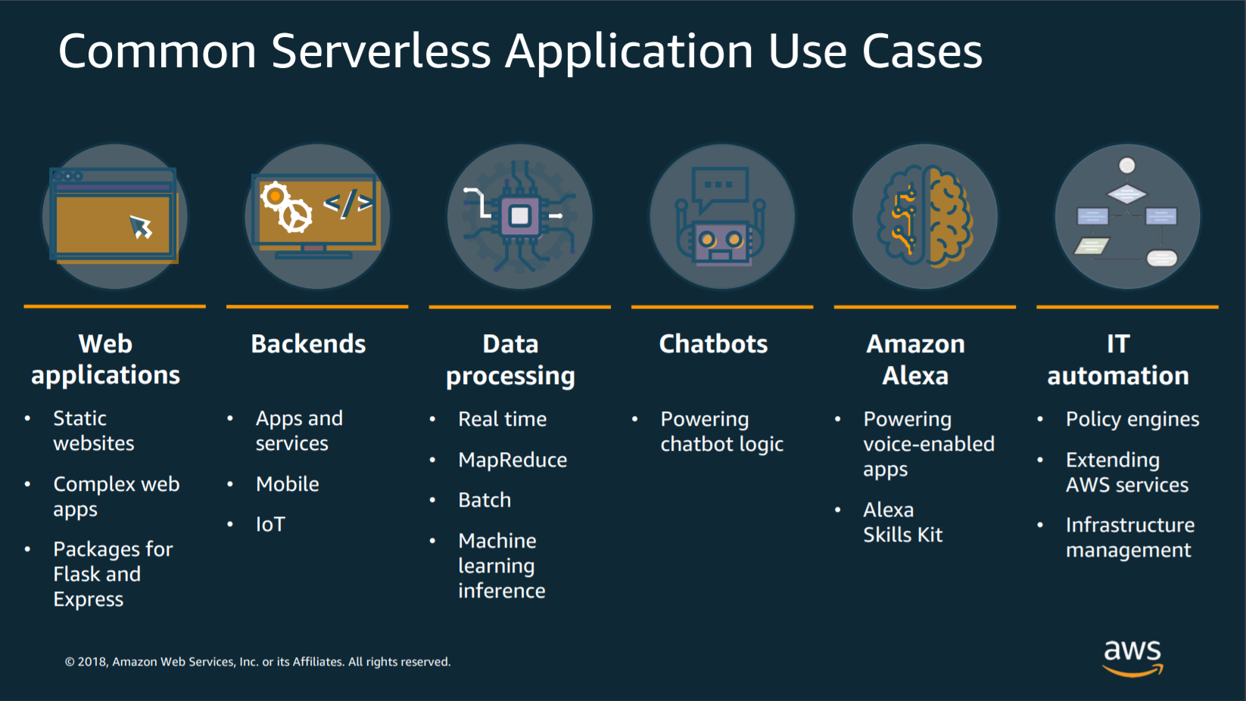

Slide 22

How to start?

Slide 23




Choose a Framework

Slide 24
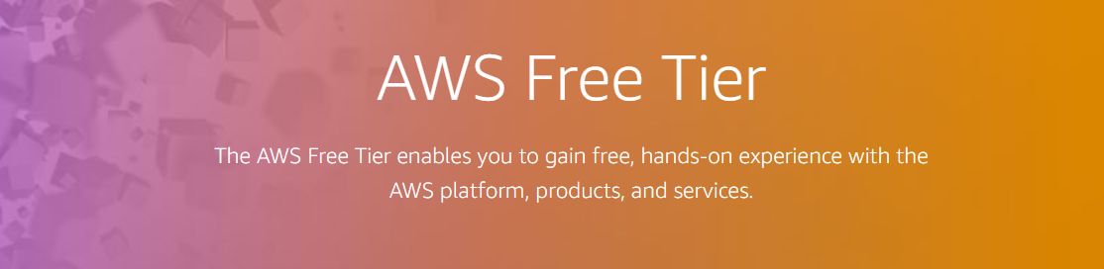
An AWS Account | Local
https://aws.amazon.com/free/
Free AWS Services
1 million Lambda Execution
5GB S3
25GB DynamoDB
62000 emails with SES

Slide 25
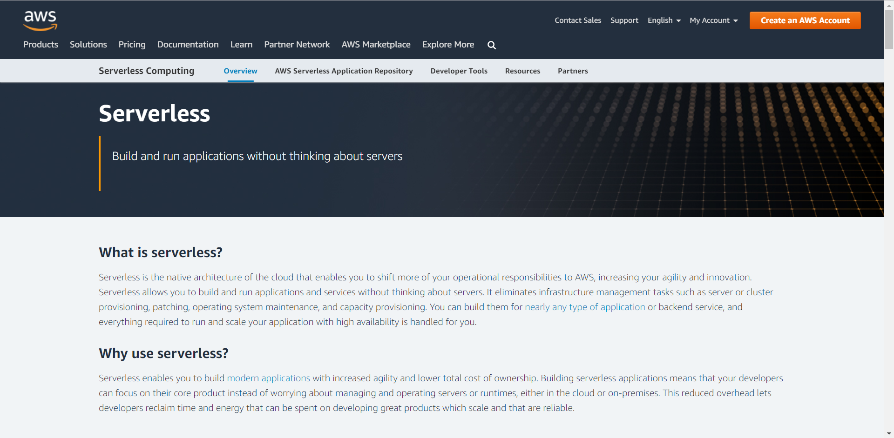
Serverless!!
https://aws.amazon.com/serverless/

Slide 26
Thank you!!
Jesús Guzmán
https://github.com/susguzman/aws-samples
jguzman@datum.com.gt
susguzman@gmail.com

